Slide 1
Bootcamp 2023: Preprocessing Annotations
bayram

Slide 2

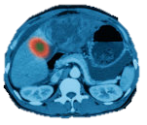
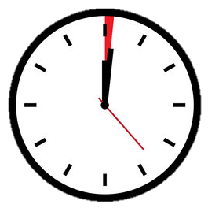
AI vs Doctors
1x + 1x = 1x

Slide 3
AI vs Doctors
1x + 1x = 1x
1x + 10000x = 10000x

Slide 4
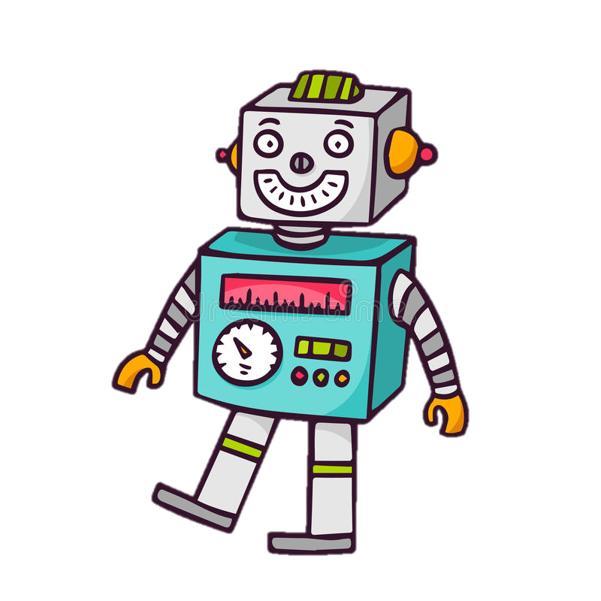
AI vs Doctors
1x + 1x = 1x
1x + 10000x = 10000x
1x + 10000 = 0.1x

Slide 5
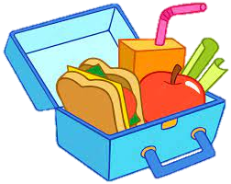
AI is like a child
Can take only one sandwich in a lunchbox
Sandwich must be assembled beforehand
Images must be preprocessed before being sent to a Neural Net
Resize / rotate the image
Normalize color
Split into standard patches
Toss all irrelevant parts (use annotations)

Slide 6
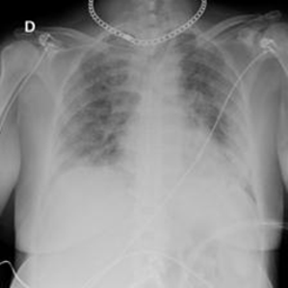
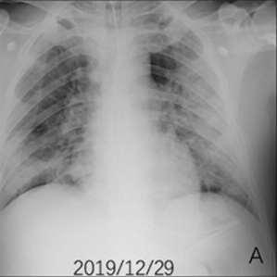
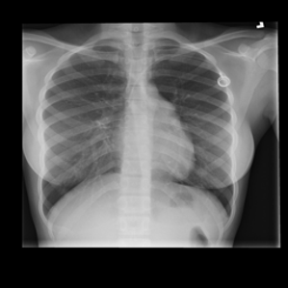
Introduction
Images come from machines
Some parts may not be relevant to research
Preprocessing
Deal with machine marks, foreign objects, incoherent geometry, etc
Remove surrounding tissue and organs from being sent to the algorithm.
kaggle.com/datasets/preetviradiya/covid19-radiography-dataset

Slide 7
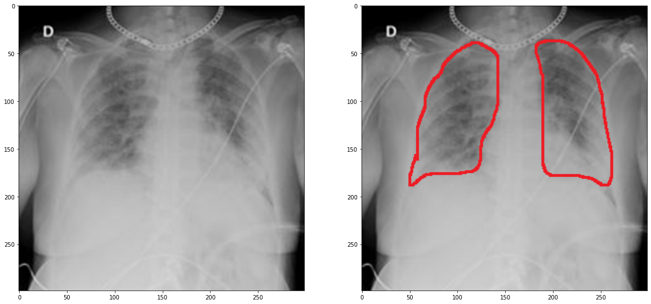
Human Annotation
MDs provide insight on the Region of Interest (ROI)
Paint (pro: widely available),
ImageScope (pro: less memory, easier processing by *you-the-pythonista*)

Slide 8
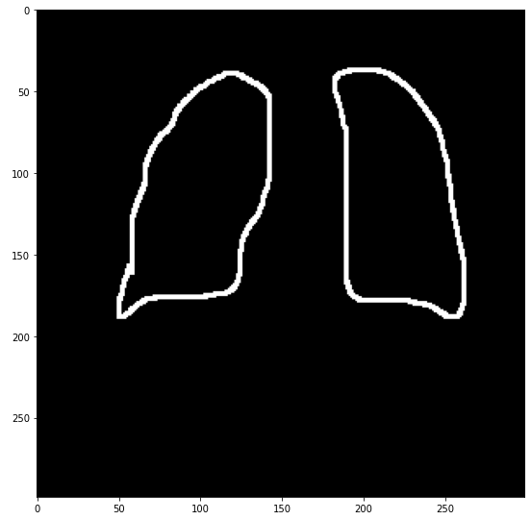
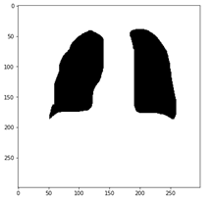
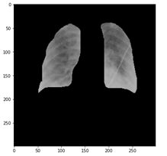
Working with annotations
Differentiating
CV/Graphics methods:
Dilation
Floodfilling
Negation
Masking

Slide 9
Floodfilling
https://en.wikipedia.org/wiki/Flood_fill

Slide 10
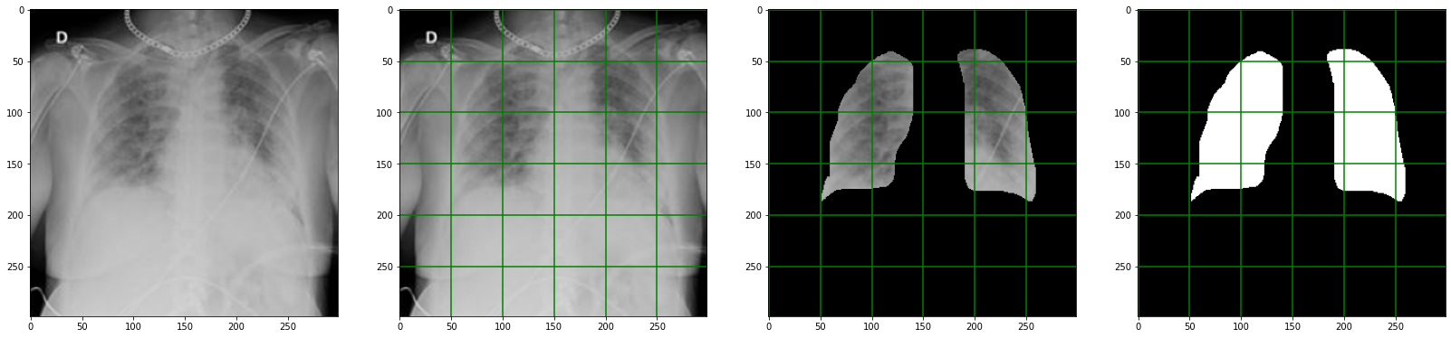
Data for the algorithm
Large images may require partition
Use the partition of the masked image
The mask plays important role
Save your every output!!

Slide 11
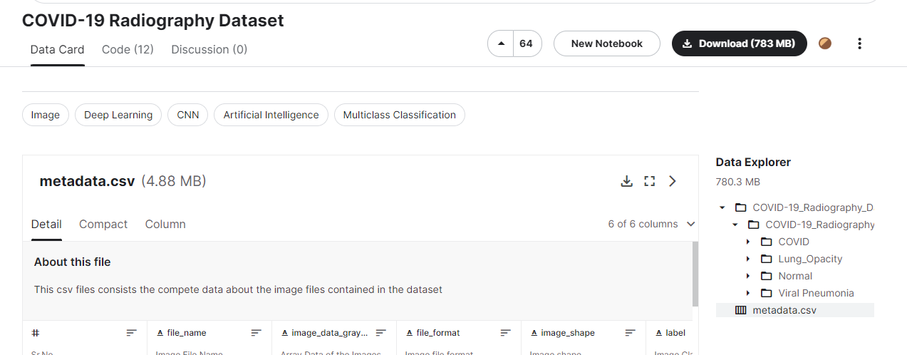
Hands-on
Dataset: kaggle.com/datasets/preetviradiya/covid19-radiography-dataset
X-rays of lungs: Normal (Healthy), Covid, etc
Download
N images from Normal set
N images from COVID set
N == 1 for today
Organize images
Produce annotations
Follow the me in Jupyter

Slide 12
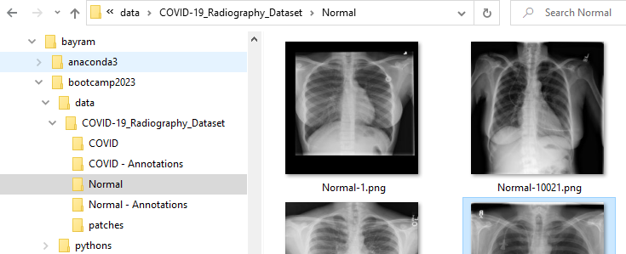
Hands-on
Dataset: kaggle.com/datasets/preetviradiya/covid19-radiography-dataset
X-rays of lungs: Normal (Healthy), Covid, etc
Download
N images from Normal set
N images from COVID set
N == 1 for today
Organize images
Produce annotations
Follow the me in Jupyter

